Slide 1
iSpindel Contents
Overview
Preface
Cherry Philip Board Layout
Build Considerations
Batteries
Charging
First Contact
WiFi connection
Setup
Ballasting
Sensor Calibration
Gravity Polynomial Generation (Rapid Version)
Gravity Polynomial Generation (Long Version)
BrewFather Connection
Reprogramming
Wemos Flashing
Wemos Re Flashing

Slide 2
1 Overview - Preface
The iSpindel uses the same theory as the Tilt. The angle of an unbalanced floating body can be plotted against the gravity and hence gravity derived from that angle.
First up the full documentation is pretty good and it’s here:
http://www.ispindel.de/docs/README_en.html

Slide 3
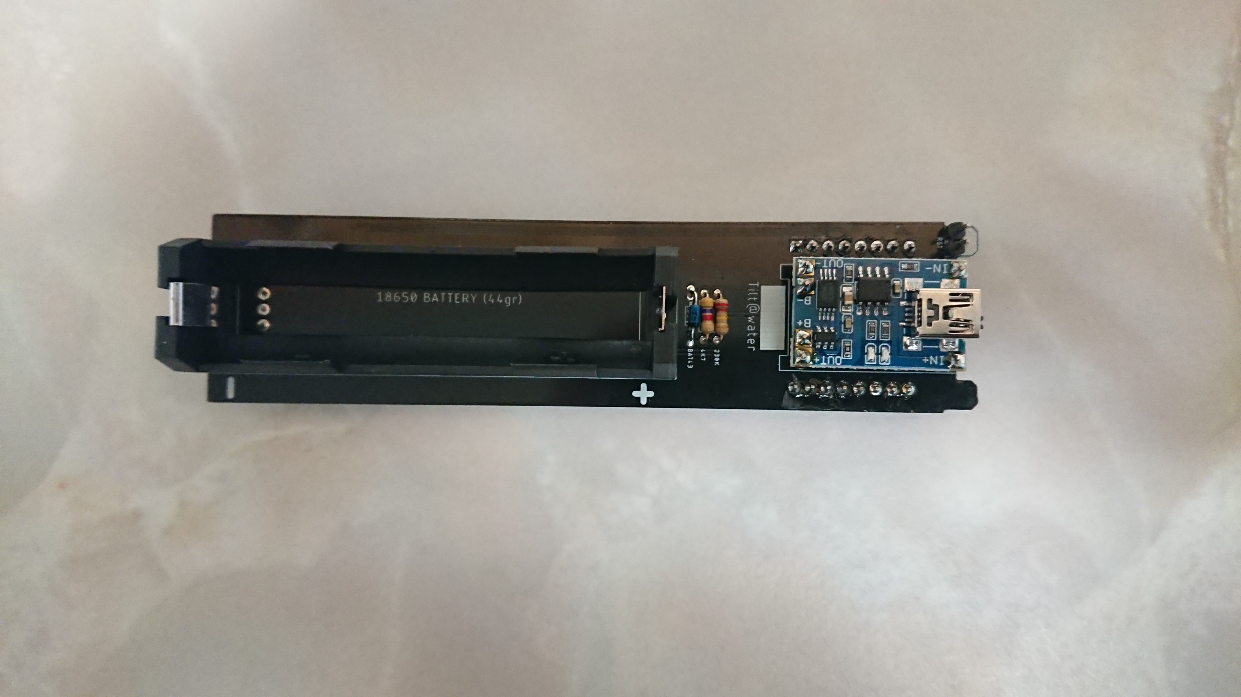
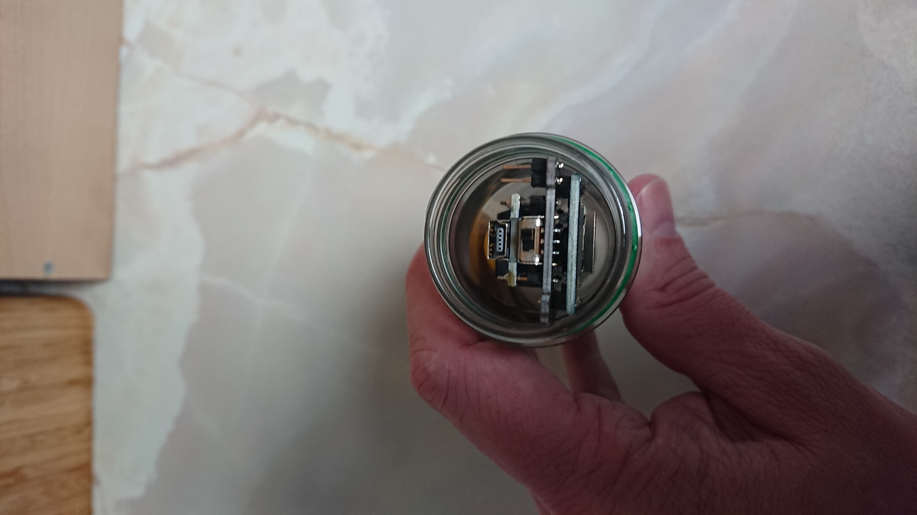
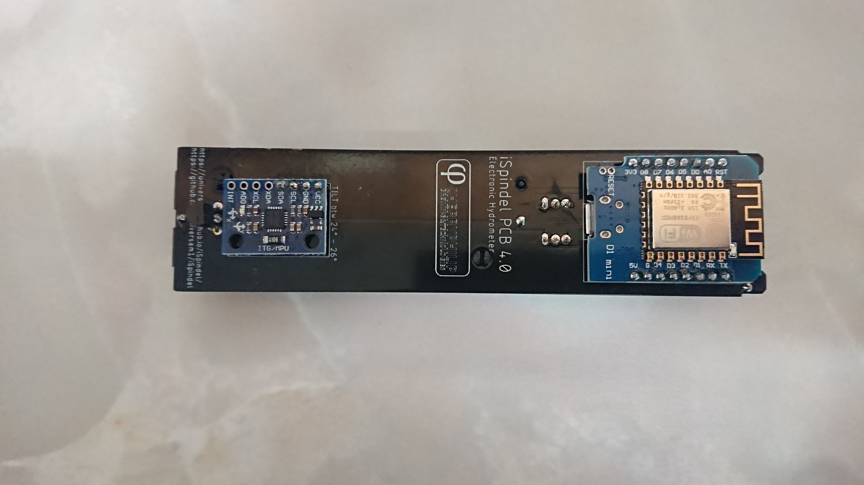
1 Overview – Cherry Philip v4.0 Board Layout
4
Battery
Resistors and Diode
Lipo Charger
Reset Contacts
Temp Sensor
Gyro Board
Wemos Board
Charge Port
On/Off switch
Programming Port
2
1
3
8
4
9
7
5
6
10

Slide 4
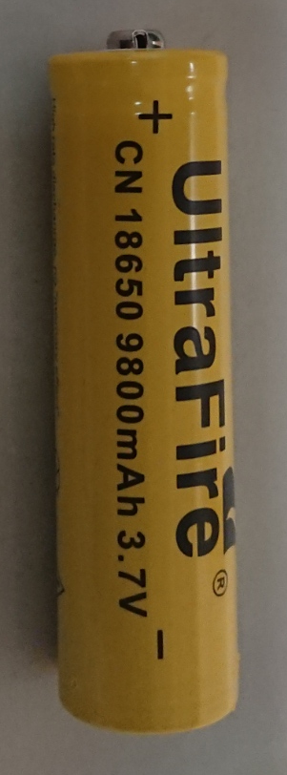
2 Build Considerations - Batteries
There are a lot of fake batteries out there so stay away from eBay and use Amazon with great care
They can be dangerous but usually are just very low capacity
Batteries are any of the 18650 types and should weigh over 42g.
If the seller doesn’t advertise battery weight don’t buy from them
If the capacity is much over 3000 mAh it’s fake, like the one opposite
I’d suggest only buying from sites with a real address and phone number who only really sell batteries
The battery above is fake no one makes a 9800 mAh battery

Slide 5
2 Build Considerations - Charging
There is no need to remove the PCB from the tube to charge the iSpindel, simply plug a USB cable into the charging port noted on slide 3, label 8
Red LED means charging
Blue/Green LED means charged
If the battery is not making contact you will notice that one of the LEDs on the charge board (Slide 3, label 3) lights and the other dimly flickers.

Slide 6
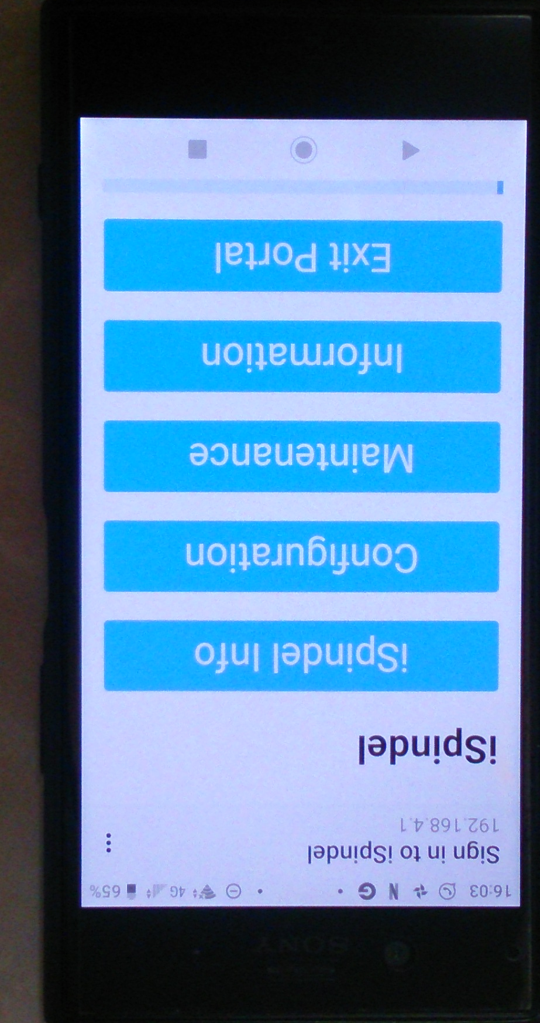
3 First Contact – WiFi connection
First flash the iSpindel as per slide 12
Make sure the battery has a good charge in it, see slide 5 for charging
Turn on the iSpindel and the blue LED (near the top) should blink repeatedly. (If the LED does not blink short the reset contacts, see slide 3, label 4).
On a mobile device go to your WiFi and join the iSpindel network
It should prompt you to Sign-In, when you do it will take you to its portal
Left long enough this portal will time out (not while you are connected though) to save battery. The device will go to sleep, wake up to send a reading and go back to sleep. To make it serve its portal again you need to short the reset contacts twice.

Slide 7
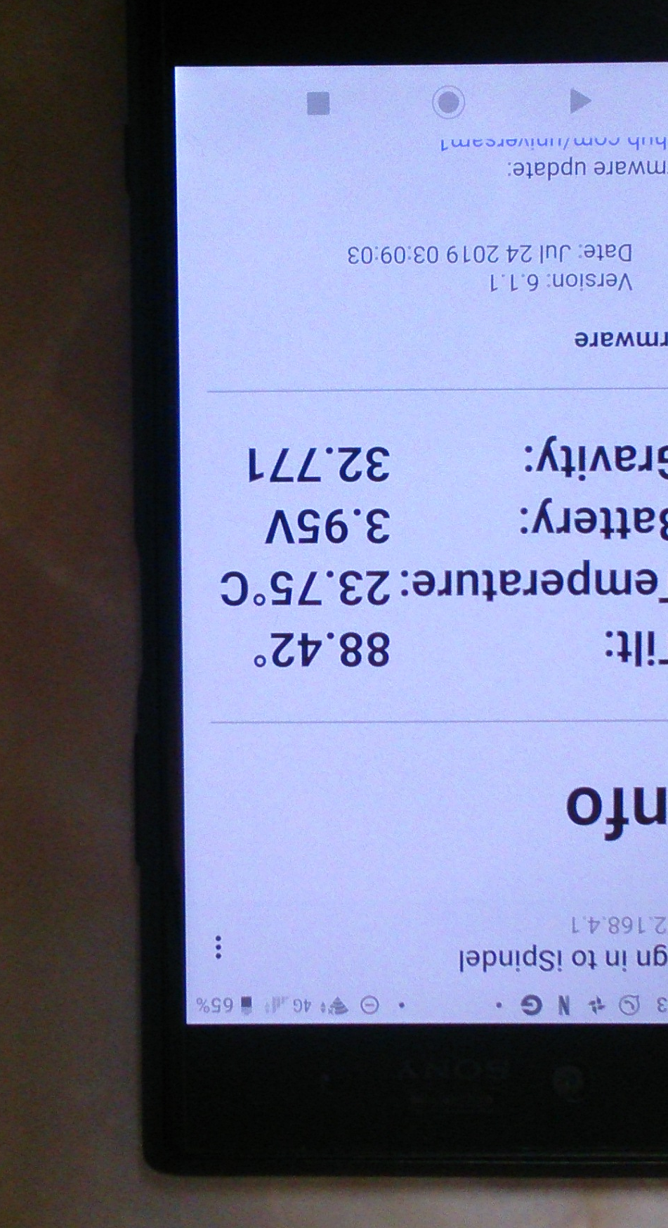
4 Setup - Ballasting
Due to differences in battery weights and the plastic tube weights some ballasting might be needed.
Once you’re connected you can read the tilt reading on the ‘iSpindel Info’ page
With a good battery (42g or more) the device should sit in tap water at about 25° (between 18° and 27° is okay)
If it reads a greater angle, you’ll need to add a little ballast, gluing a coin to the board works well, keep it centre aligned and as far from the tube opening as possible
Once done, glue everything in place, including the circuit board. If things move around this will affect the reading.

Slide 8
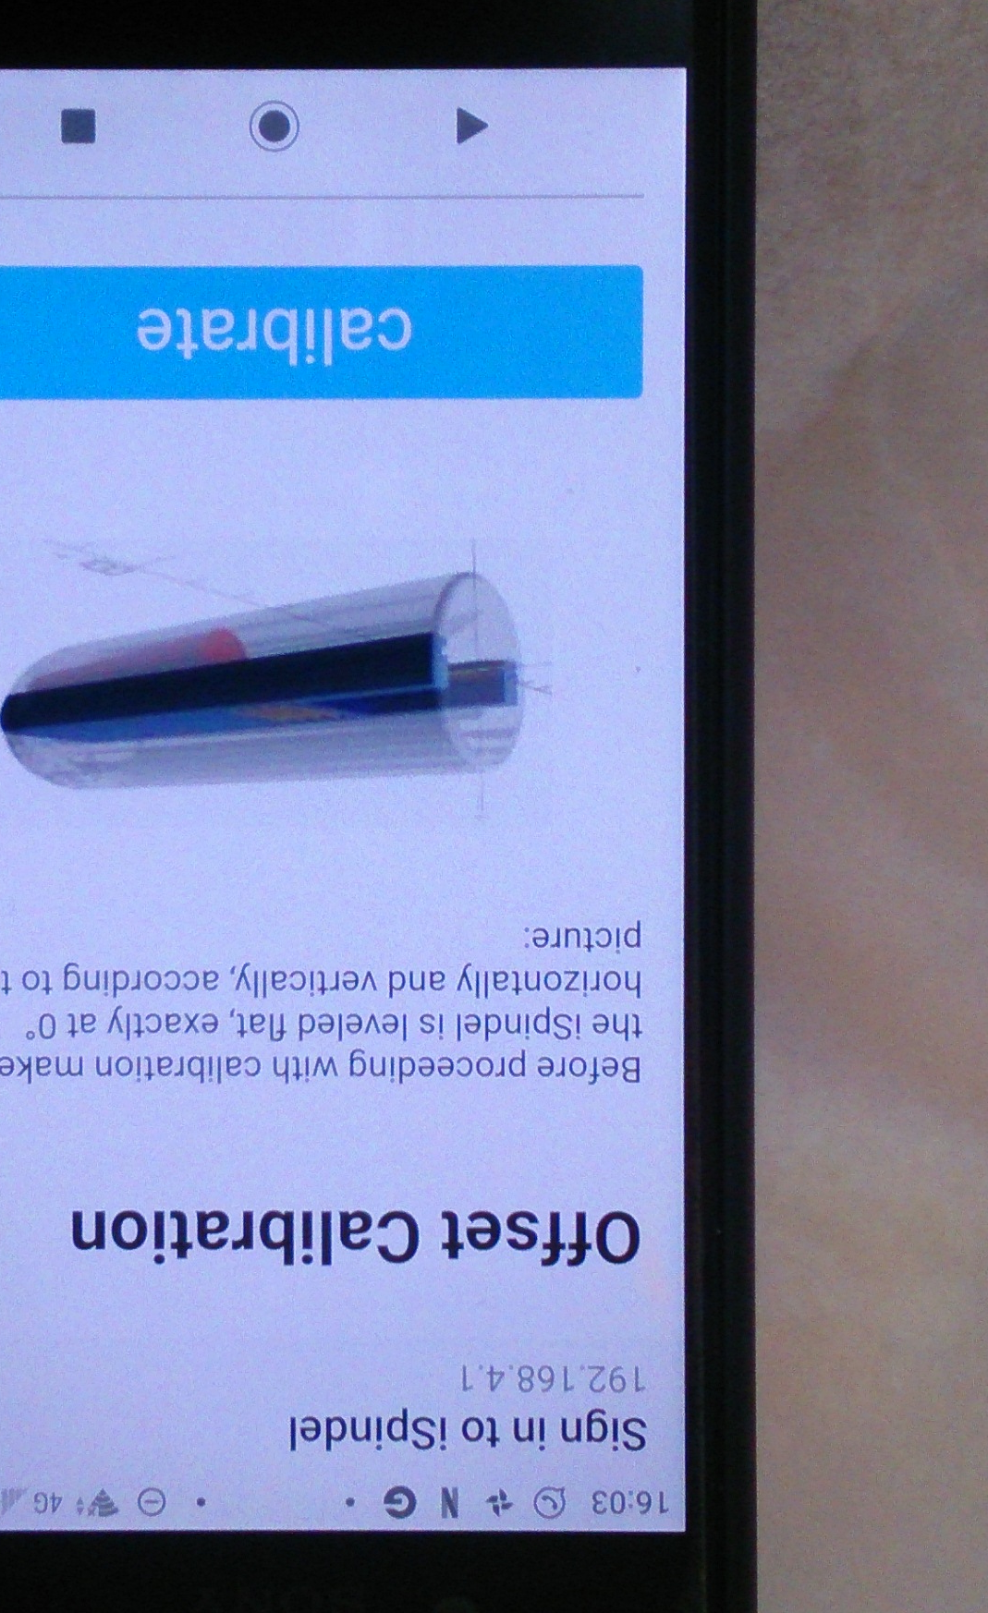
4 Setup – Sensor Calibration
Switch the device on close the tube and get a connection to the portal
Lie the device such that the centre line is horizontal, you may need to prop up the rounded end up a little
Go to the calibration page and push the ‘calibrate’ button. Wait briefly.

Slide 9
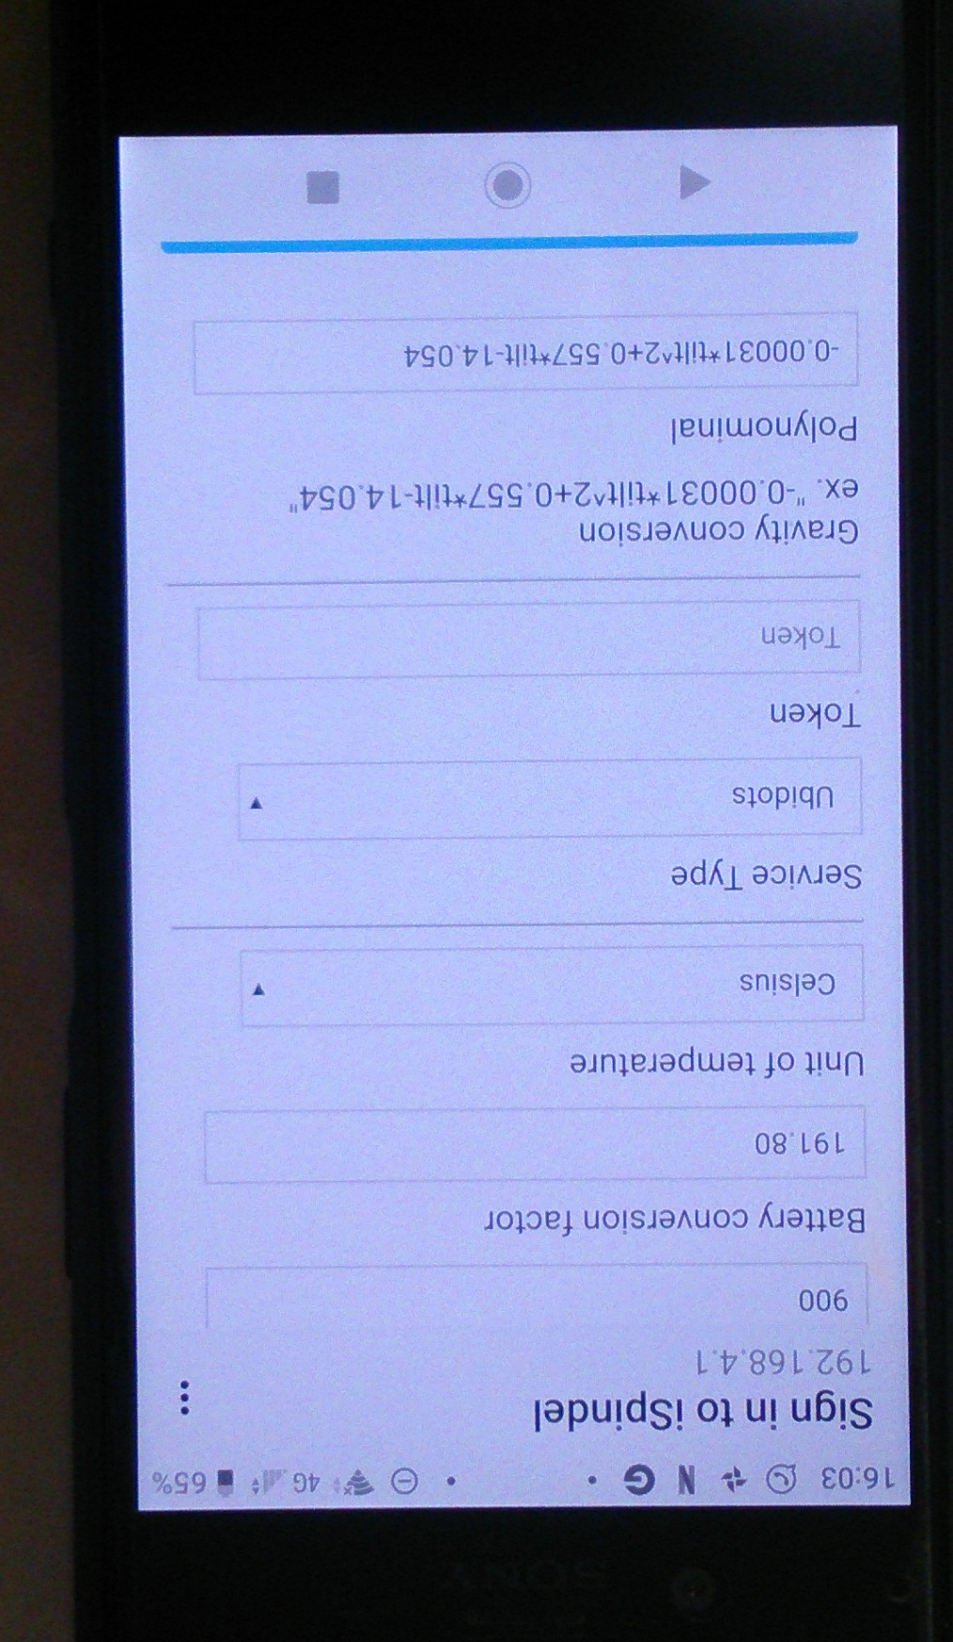
4 Setup - Gravity Polynomial Generation (Rapid Version)
Pop your iSpindel in room temperature tap water
Connect to the portal to read the iSpindel tilt reading
The following spreadsheet can be used to estimate the polynomial needed based on readings from other Cherry Philip based iSpindels:
https://github.com/universam1/iSpindel/blob/master/docs/iSpindelPolyEstimator.xlsx
Follow the instructions to generate the polynomial and copy into the Polynomial box in the iSpindel setup page.

Slide 10
4 Setup - Gravity Polynomial Generation (Long Version)
See: http://www.ispindel.de/docs/Calibration_en.html
Grab a bag of sugar and a bucket of water
Connect to the portal to read the iSpindel tilt reading
Take readings of the tilt value and hydrometer Gravity/Plato reading from tap water up to the highest Gravity/Plato you’ll brew to
Plot the reading pairs in Excel and have it regress a line to give the tilt to Gravity/Plato calculation
Enter that calculation into the portal page ‘Configuration’ under ‘Polynomial’
Alternatively for a Cherry Philip v4.0 board that hangs at 25°, try a polynomial of:
(1.0000E-6*(tilt^3))-(1.3137E-4*(tilt^2))+(6.9680E-3*tilt)+(8.9493E-1)

Slide 11
BrewFather Connection
See the Brewfather instructions they are pretty good: https://docs.brewfather.app/integrations/ispindel
Note if your iSpindel reports in SG end the name of your device with “[SG]”. I.e. “MyiSpindel[SG]”

Slide 12
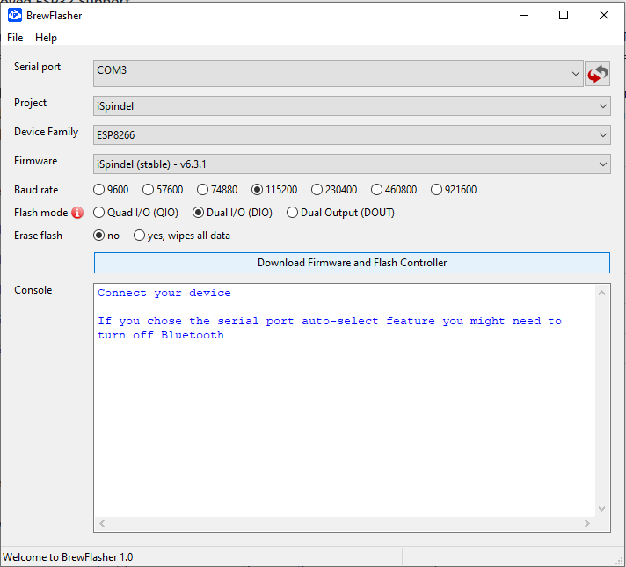
6 Reprogramming – Wemos Flashing
This is easily done using BrewFlasher
https://github.com/thorrak/brewflasher/releases
Use the Programming port shown on slide 3, label 10

Slide 13
6 Reprogramming – WiFi Re Flashing
Once the Wemos has been Flashed it can be re flashed via its web portal
Grab the latest firmware: https://github.com/universam1/iSpindel/releases
Push the blue ‘firmware.bin’ link
Get a connection see slide 6
Go to the Maintenance screen in the portal
Under ‘Firmware Update’ hit ‘Browse…’
Locate your firmware file (As of 16/06/2030 6.3.1 is the latest), select it and hit ‘Open’
Press the blue Update button and wait for the Success screen
Done!

